Slide 1
COST BUDGETING

Slide 2
Introduction
Every project boils down to money. If you had a bigger budget, you could probably get more people to do your project more quickly and deliver more. That’s why no project plan is complete until you come up with a budget.
An amount that has to be paid or given up in order to get something that is said to be “COST”.
Cost refers to how much we spent creating something.

Slide 3
Introduction
A budget is a document for recording actual and projected income and expenditures over time.
Budgeting is the process of setting financial goals, forecasting future financial resources and needs, monitoring and controlling income and expenditures, and evaluating progress toward achieving the financial goals.

Slide 4
Cost v/s Budget
Costing is the process in which a firm attempts to estimate the costs involved in the production of one unit of output. Costing requires the use of historical information; that is concerned with the past costs incurred by the business, and this information is used to predict the future cost structure.

Slide 5
Cost v/s Budget
Considering an example for costing in the clothing business, costing will include the estimation of the costs of the material, buttons, designs of clothing, as well as labour costs, factory production costs per unit, and holding costs of stocks of inventory. Cost allows the firm to evaluate and estimate the costs to be incurred in the future and make arrangements for reducing those cost levels.

Slide 6
Cost v/s Budget
Budgeting involves the business, making a plan regarding the costs to be incurred for each activity or department in the organisation and ensure that payments are made out of funds allocated in the plan. Budgeting allows a firm to keep its costs efficiently to the planned levels and results in less overspending.
Costing keeps a track of the costs that are incurred in each stage of production, whereas budgets exercise control over where money is spent, and for what purposes money is allocated.

Slide 7
Project cost management
Project cost management includes the processes required to ensure that the project is completed within an approved budget
Planning cost management: Determining the policies, procedures, and documentation that will be used for planning, executing, and controlling project cost

Slide 8
Estimating costs: Developing an approximation or estimate of the costs of the resources needed to complete a project
Determining the budget: Allocating the overall cost estimate to individual work items to establish a baseline for measuring performance.
Controlling costs: controlling changes to the project budget.

Slide 9
Cost budgeting
A project cost budget is the total sum of money allocated for the particular purpose of the project for a specific period of time. The goal of cost budget management is to control project costs within the approved budget and deliver the expected project goals.
Cost budgeting includes the estimation of costs, setting a fixed budget, and managing and controlling the actual costs (compared to the estimated ones). The costs then have to be allocated to the activities or work packages in a project.

Slide 10
Cost budgeting
Changes to the cost plan/Budget should be made in the following cases:
There are scope changes
A new cost budget is more realistic
If the planned costs are not sufficient for a particular task.

Slide 11
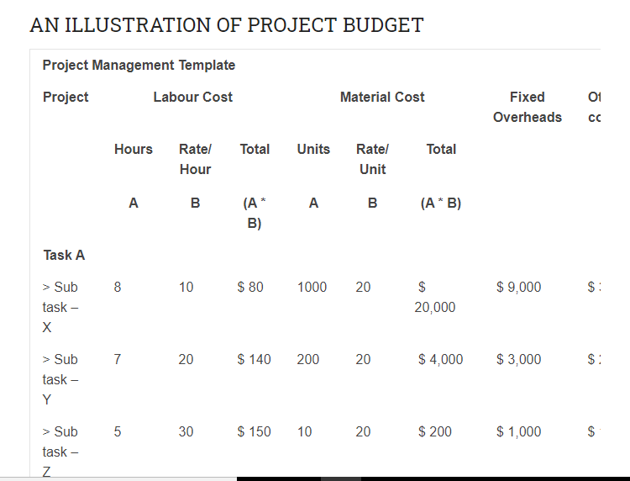

Slide 12
COST BUDGETING METHODS
The analogous budget tool uses the actual costs from a previous project to estimate the budget for a current project. This method can be used for multiple projects, as long as they are similar in nature.
The top-down budget method looks at the total project budget and estimates costs for each process in the project. This method looks at each activity needed to complete the project or the number of outputs from the project when estimating costs

Slide 13
COST BUDGETING METHODS
The bottom-up budget tool uses the costs of all economic resources or inputs used in a project to determine the total project budget. This method is a variable budgeting method since the cost of inputs can vary depending on the availability or quality of the inputs.
Parametric-estimate method is based on cost-accounting information such as process costing tools or cost allocation methods that attribute business costs to goods and services. This method uses standard mathematical calculations.

Slide 14
ADVANTAGES OF PROJECT BUDGET
BETTER PLANNING
A project budget is an important tool for project planning. It helps in better execution of the project. It indicates the available resources and how to effectively utilize those resources. The project budget is the financial roadmap of any organization.

Slide 15
ADVANTAGES OF PROJECT BUDGET
PRIORITIZATION
Sometimes the initially allocated proportion of finance is not sufficient for the completion of the project. The project budget shall help in prioritizing which part of the budget is important and required to be completed on urgent basis.
HANDY MANAGEMENT TOOL
At any time, the management uses as a tool for verifying that the project team is achieving the targets as per the budget.

Slide 16
What is Risk in Project Management?
Risk is any unexpected event that can affect your project. Risk can affect anything: people, processes, technology, and resources. Risks are events that might happen, and you may not be able to tell when.

Slide 17
Types of Project Management Risks
Quality - There could be an issue with the quality of the project deliverables not meeting standards and expectations.
Cost - This one is pretty self explanatory. Are there parts of the project that could cost more than originally scoped? This could be things such as technology, people, or simply the project taking much longer than anticipated causing increases to cost.
Timing - Could the project take longer time than anticipated.

